Slide 1

Title Page
Everything you need to start an FSU Club!

Slide 2
The FSU Club Toolbox
Table of Contents
This document contains everything you need to start an FSU Club! From procedures and requirements down to helpful tips, this toolbox will help guide you through the first steps of starting a club.
Note that all the information in this toolbox is in line with the FSU Clubs Policy 2026-2027 and that you should review these policies as best as you can.
For more information, feel free to contact fsuclubs@fanshawec.ca or get connected with the VP of Student Engagement through fsustudentengagement@fanshawec.ca
FSU Clubs…………..……………………….…………3
Starting an FSU Club………………………….……4
Club Charter………………………………………5
Review Periods…………………………..…………..8
Approval and Orientation……………….…...…..9
FAQ……………..……………………………………...10

Slide 3
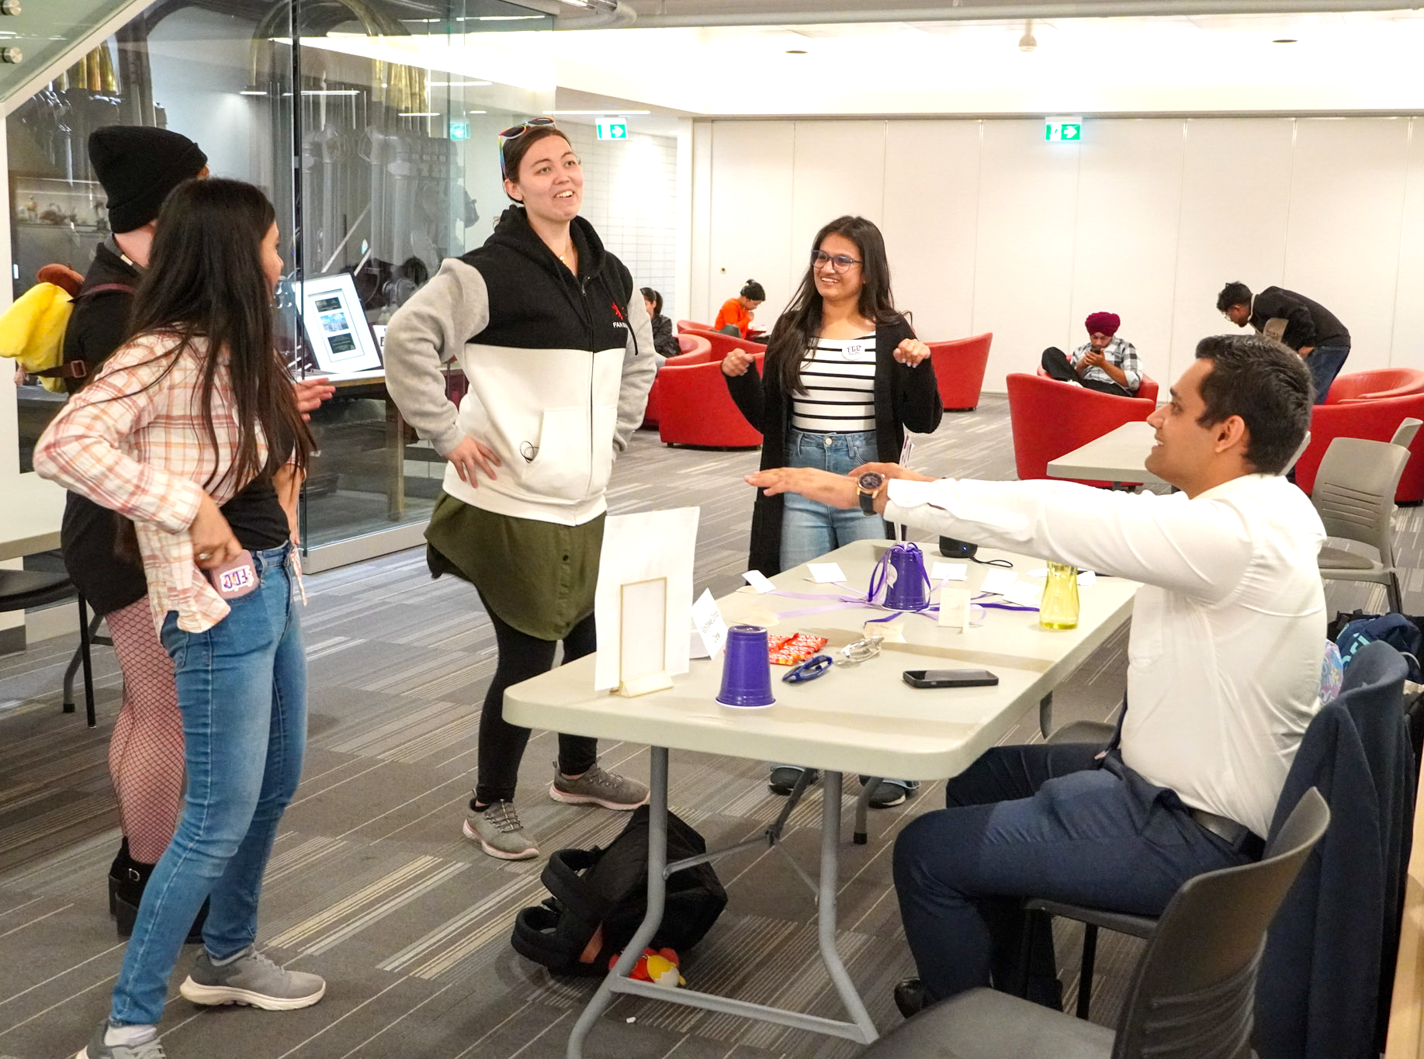
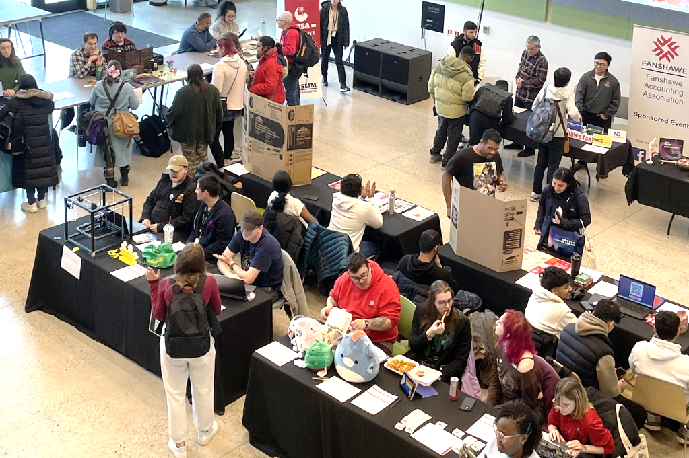
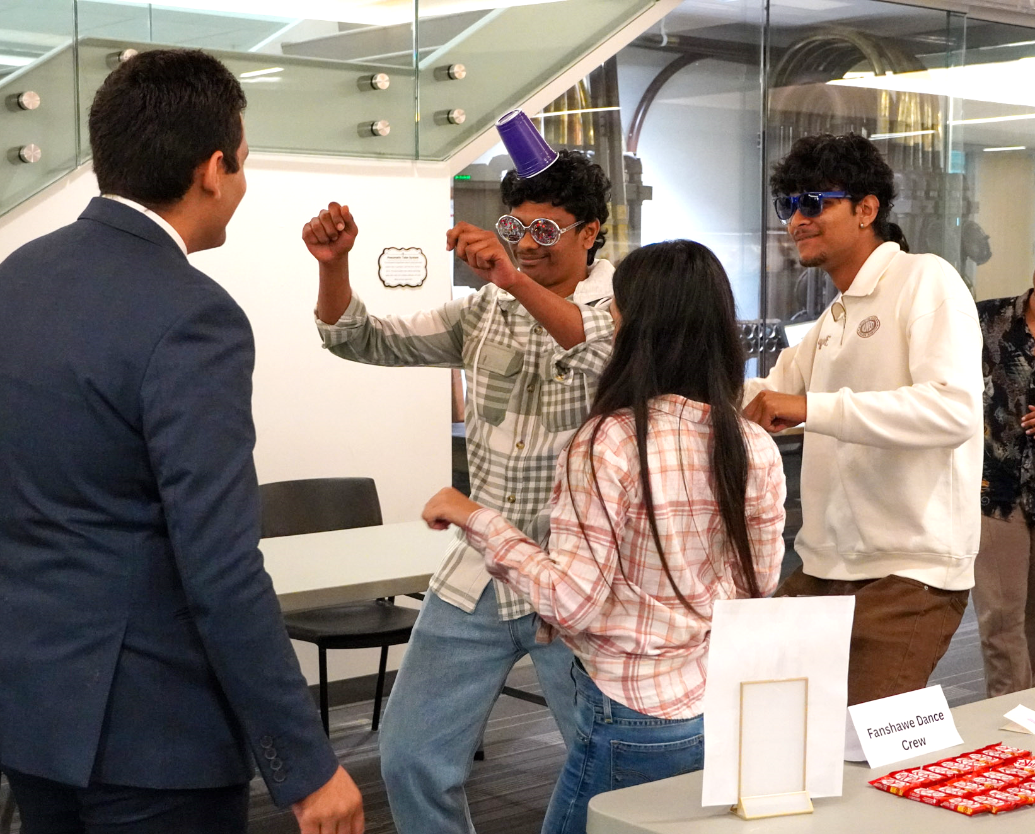
FSU Clubs
FSU Clubs are an amazing way to network, develop skills like leadership and organization, engage with communities, and of course, have fun! Clubs can host events in the Student Centre, the College, and other campuses for both their club members and the student body.
Club Leadership Team positions in FSU Clubs qualify to be added to students’ Co-Curricular Record (CCR).

Slide 4
Starting an FSU Club
Start by giving the FSU Clubs Policy a quick look!
FSU Clubs Policy contains a definition of terms used within the FSU Clubs Program, and a comprehensive breakdown of the rules, requirements, and procedures for starting and operating a club.
Filling the Club Charter Form
For a FSU Club to be formed and ratified, students must fill in the Club Charter Form available on the FSU Clubs site, along with every other document related to the FSU Clubs Program. The Club Charter details everything we need to know about your club, from the name and type of club down to who the club leaders and members are.
Once this charter is completed and submitted to the FSU, it will be reviewed to ensure that all requirements are met and that the club is eligible for ratification. If so, the Club President will be notified, and the Club Leadership Team would go through orientation, and the club will be able to begin operations!

Slide 5
Club Charter
1. Name of the Club
Pick a name that’s relevant to the kind of club you want to run. Note: You cannot use “Student Union” in the name of your club. However, names such as “Fanshawe ___________ Club” are allowed.
2. Club Logo
Clubs must have their own club logo. This will be shown on the FSU Clubs listing page and can be used for promotional purposes, such as campus posters or social media posts.
3. Type of Club
Select which of the options describes your club best. Refer to FSU Club Policy, Section 1.2.1, for definitions of club types. Note: Recreational Clubs, Campus Charters, and Program Associations may need to complete additional steps to become a ratified FSU Club. High-risk clubs will not be approved by the FSU.
4. Planned Events
Come up with some ideas for meetings, events, and activities that your club might perform throughout the year, tentative dates, and the steps involved. You can also attach a spreadsheet of these items if you would like your submission to be more organized.
Note: these do not need to be set in stone; they give the FSU Executive Committee an idea of what kind of things your club will do.

Slide 6
Club Charter
5. Club Leadership and Membership
A club will need a minimum of 5 full-time students (including the Club Leadership Team) to be ratified, and 10 to qualify for funding.
The Club Leadership Team consists of the following:
President
Vice President
Treasurer
For a detailed description of each role’s responsibilities, please refer to the FSU Clubs Policy, section 1.2.
Note: Each role must be filled by different students – the President or Vice President cannot hold the role of Treasurer.
Note: If you are applying as a Program Association or has a Faculty/Staff advisor, their information needs to be included in the charter as well. Their role is not to run the club but to provide support and guidance to the Club Leadership Team.

Slide 7
Club Charter
5. Club Leadership and Membership
If the FSU Club has any pre-made social media groups, this is also the section where you would include this. The Leadership Team is in charge of creating and moderating these platforms, ensuring that FSU Club Policies and the Student Code of Conduct is followed.
FSU Clubs typically create pages and groups on Instagram, Facebook, WhatsApp, and Discord. Links to these can be included on the Club Charter, or the Student Leadership Team can follow up with the FSU Team to update these on the FSU Clubs site.
Note: If the club is an on-campus charter or is partnered with any professional association/business, you must include their information and attach a copy of the organization’s Certificate of Liability Insurance and complete an ‘Off Campus Endorsement Form’.
Club membership must be open to all students at Fanshawe College and must not be restricted based on any grounds. Part-time students may join the club and its activities, but they will not count towards the 5 and 10 members eligibility requirements and they cannot hold any leadership position(s) within the club.

Slide 8
Review Periods
Club Charter submissions can be submitted throughout the year. However, FSU Clubs can only be ratified during the review period for each semester.
If you would like your Club Charter to be reviewed for the current semester, keep the following dates in mind:
Fall Semester: November 1
Winter Semester: March 1
Summer Semester: June 1
Note: If you submit after these dates, it does not mean your Club Charter automatically will be declined! Club Charters submitted after these dates will be be held until the following academic semesters to be brought forward, if eligibility criteria are met.

Slide 9
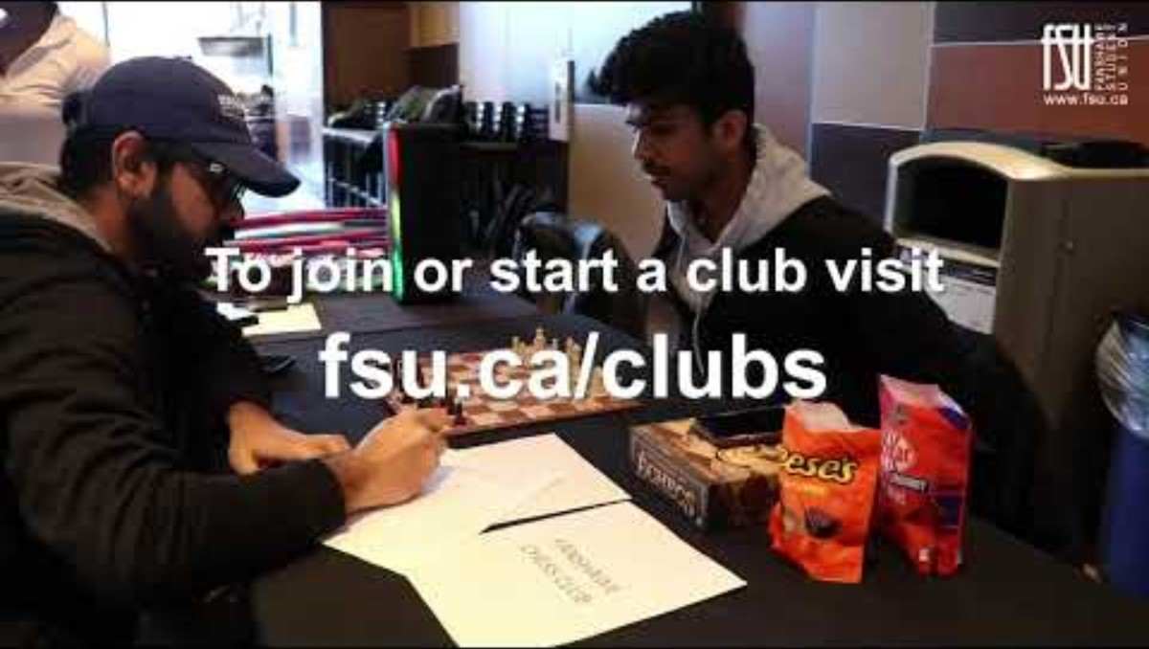
Approval and Orientation
Once the Club Charter has been submitted, it will be reviewed by the FSU Executive Committee. The VP, Student Engagement will inform the Club of the outcome; if successfully approved or if the Club Charter is denied with an explanation.
If approved, the FSU Club Leadership Team must complete Clubs Orientation led by the VP, Student Engagement, and review and sign the FSU Clubs Policy. During Clubs Orientation, leaders will go through the details of operating an FSU Club, and the support available to clubs.
If a club is ratified at the start of the term, they’ll
be able to represent their club at !Clubs Day!, an
event held at the start of each term to spread
awareness of active FSU Clubs!
The Club Leadership Team will receive
information on how to sign up for a table on
Clubs Day, and you can engage with students
that show interest in joining.

Slide 10
FAQ
– What kind of club can I start?
You can start almost any kind of club! The Fanshawe Student Union encourages students to start clubs based off common interest, program associations, culture or religion, recreational, community service, and many more!
– Do I need a Faculty/Staff advisor?
It is not mandatory to have a Faculty or Staff Advisor. However, it is suggested that Program Associations or any Club supported by a College department have a faculty or staff advisor. It was important to remember that these Advisors are there to provide support, not run the day-to-day club activities.
– Will my Club receive funding?
Clubs with 10 or more active members are automatically qualified to receive club funding. Follow the procedures for reimbursement and financial reporting as outlined in the FSU Club Policy.

Slide 11
FAQ
– Can my Club host events?
Yes! If your Club would like to host an event, the President of the Club must complete an Event & Activity Application at least 2 weeks before the event for approval. The President will receive notice via email if the event has been approved or denied. If the event has been approved, planning for the event can begin.
Note: High Risk events will not be approved under any circumstances. Please include the space you would like to use for your event (i.e. FSU Clubrooms, specific college space, etc.) Forwell Hall/OBS cannot be booked for Club Events.
– How do I book College Space (i.e. classroom or lecture theater)?
An Event & Activity Application must be submitted online before the proposed date of your meeting/event, and the FSU will direct the Club to the correct contact within the College.

Slide 12
FAQ
– Can we collaborate with other clubs for events?
Yes! Clubs are encouraged to collaborate with each other for events and activities. This can enhance the experience for members and broaden the reach of the event
– How can we promote our club on campus?
Clubs can promote their activities through various channels, including social media, posters, tables, and the FSU website. Be sure to use ‘poster template’ for all Club Events.

Slide 13

Have more questions?
Contact the VP, Student Engagement
fsustudentengagement@fanshawec.ca
Or the FSU Clubs Team
fsuclubs@fanshawec.ca

