Slide 1
FSU Clubs Toolbox
Everything you need to run an FSU Club!

Slide 2
The Clubs Toolbox
This document contains everything you need to start or run an FSU Club! From procedures and resources down to helpful tips to operate as efficiently as possible.
Note that all the information in this toolbox is in line with the Clubs Policy 2025-2026 and that you should review these policies as best as you can.
For more information, feel free to contact fsuclubs@fanshawec.ca or get connected with Gideon Bett, VP of Student Engagement through fsustudentengagement@fanshawec.ca
Table of Contents
Starting a Club…………………………………..……3
Club Charter………………………………………5
Approval and Training…………………………..8
Hosting Events ……………………………………....9
Event & Activity Application Form…….……..10
Catering with the FSU………………………..12
Advertising with the FSU ……………………13
Event Guide – Movie Nights …………………...16
Event Guide – Off-Campus Events ………….17
Forms and Reports ……………………….………18

Slide 3
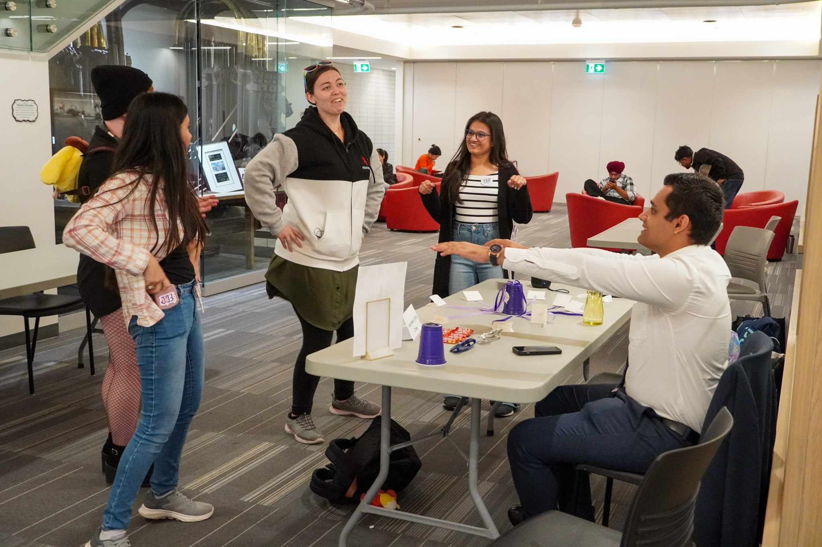
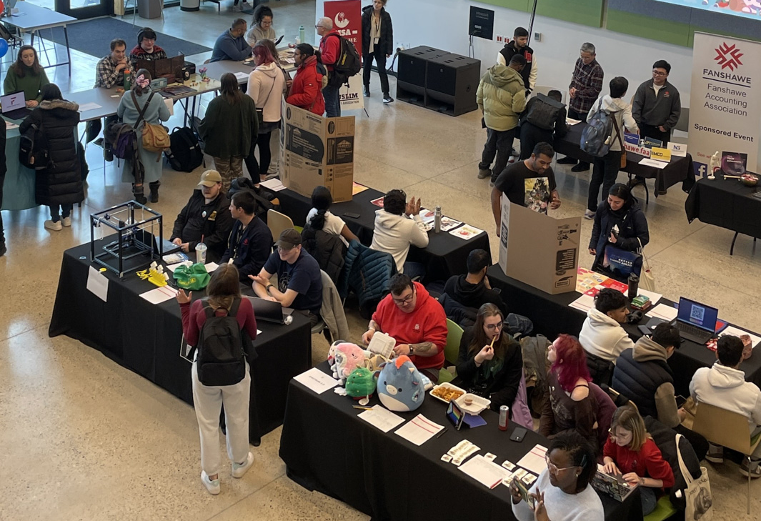
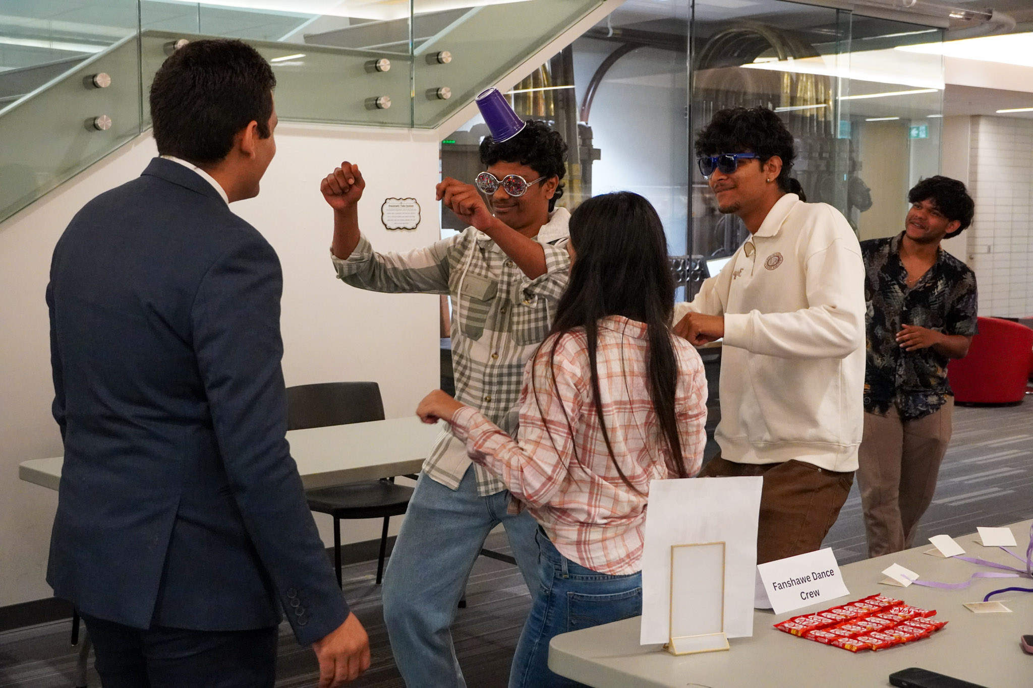
Starting a Club
Clubs are an amazing way to network, develop skills like leadership and organization, engage with communities, and of course, have fun! Clubs can host events in the Student Centre, the College, and other campuses for both their club members and the student body.
Executive positions in Clubs qualify to be added to students’ Co-Curricular Record (CCR).

Slide 4
Starting a Club
Clubs Policy
Start by giving the Clubs Policy a quick look. It contains a definition of terms used within the Clubs Program, and a comprehensive breakdown of all the rules and procedures in operating a club.
Club Charter Form
For a club to be formed and ratified, students must fill in the Club Charter Form available on the FSU Clubs site, along with every other document related to the Clubs Program. The Club Charter details everything we need to know about your club, from the name and type of club down to who the executives and members are.
Once this charter is completed and submitted to the FSU, it will be reviewed to ensure that all requirements are met and that the club is eligible for ratification. If so, the Club President will be notified, and the Club Executives would go through training, and the club will be able to begin operations!

Slide 5
Club Charter
01. Name of the Club
Pick a name that’s relevant to the kind of club you want to run. Note: You cannot use “Student Union” in the name of your club. However, names such as “Fanshawe ___________ Club” are allowed.
02. Club Logo
Clubs must have their own club logo. This will be shown on the FSU Clubs listing page and can be used for promotional purposes, such as campus posters or social media posts.
03. Type of Club
Select which of the options describes your club best. Refer to Club Policy, Section 1.2.2, for definitions of club types. Note that Recreational Clubs, Campus Charters, and Program Associations may need to complete additional steps to become a ratified FSU Club.
04. Planned Events
Come up with some ideas for meetings, events, and activities that your club might perform throughout the year, tentative dates, and the steps involved. You can also attach a spreadsheet of these items if you would like your submission to be more organized.
Note that these do not need to be set in stone; they give the FSU Executive Committee an idea of what kind of things your club will do.

Slide 6
Club Charter
05. Club Leadership and Membership
A club will need a minimum of five (5) full-time students (including the Leadership Team) to be ratified, and ten (10) to qualify for funding.
The Leadership Team consists of the following:
President
Vice President
Treasurer
These roles are responsible for properly managing the club and abiding by the FSU Clubs Policy. Note that each role must be filled by different students – the President or Vice President cannot hold the role of Treasurer.
If you are applying as a Program Association or has a Faculty/Staff advisor, their information needs to be included in the charter as well. Note that their role is not to run the club but to provide support and guidance to the Leadership Team.

Slide 7
Club Charter
05. Club Leadership and Membership
If the Club has any pre-made social media groups, this is also the section where you would include this. The Leadership Team is in charge of creating and moderating these platforms, ensuring that Club Policies and the Student Code of Conduct is followed.
Clubs typically create pages and groups on Instagram, Facebook, WhatsApp, and Discord. Links to these can be included on the Club Charter, or the Leadership Team can follow up with the FSU Team to update these on the FSU Clubs site.
If the club is an on-campus charter or is partnered with any professional association/business, you must include their information and attach a copy of the organization’s Certificate of Liability Insurance and complete an ‘Off Campus Endorsement Form’.
Club membership must be open to all students at Fanshawe College and must not be restricted based on any grounds. Part-time students may join the club and its activities, but they will not count towards the five (5) and ten (10) member eligibility requirements and they cannot hold any leadership position(s) within the club.

Slide 8
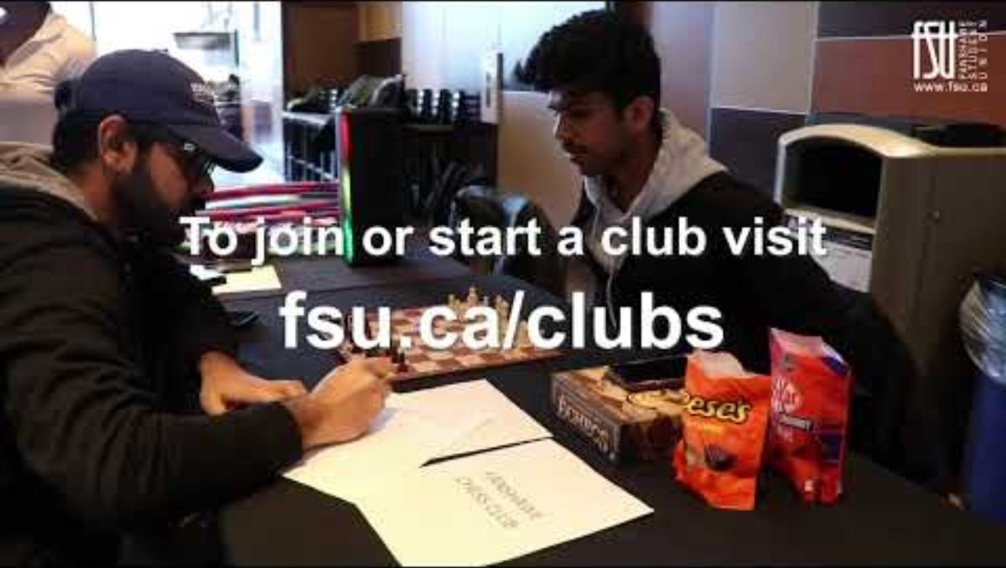
Approval and Training
Once the Club Charter has been submitted, it will be reviewed by the FSU Executive Committee. The VP, Student Engagement will inform the Club of the outcome; if successfully approved or if the Club Charter is denied with an explanation.
If approved, the Club Leadership Team must undergo training, and review and sign the Clubs Policy. Only after will the Club be able to hold events or meetings and be added to the FSU website.
If a club is ratified at the start of the term, they’ll
be able to represent their club at Clubs Day, an
event held at the start of each term to spread
awareness of active FSU Clubs!
The Club Leadership Team will receive
information on how to sign up for a table on
Clubs Day, and you can engage with students
that show interest in joining.

Slide 9
Hosting Events
FSU Clubs can host meetings, events, parties, and other club activities! All events must be submitted for approval through the Event & Activity Application Form.
Event/Activity Forms must be submitted at least two (2) weeks in advance of the event – this includes all details/requirements for the event. All events are subject to an approval process by the FSU. Subsequent planning such as securing space, purchasing items, etc., must be put on hold until a decision has been made and shared to the Leadership Team via email.
Larger-scale events (e.g. open mic, pub night, etc.) must be submitted at least two (2) months in advance and must be held in collaboration with the FSU Student Experience Team. These events must be open for all students to attend.
Note that high-risk events or activities will not be approved or recognized by the FSU. For more information, refer to the Clubs Policy, Section 1.7.1..

Slide 10
Event & Activity Application Form
Purpose of Event
Give a brief explanation of what the event is meant to be.
Example: 1st Meeting - Introduction of the Club Officers and Members, presentation on club rules and incoming plans
Check the box on whether it is a club meeting or event, or fill in the explanation for any other kind of event (ex. Charity or fundraising)
Location of Event
Clubs may request the use of spaces within the FSU such as the SC2012/SC2014 Club Rooms and Alumni Lounge. Forwell Hall or The Out Back Shack cannot be booked for events or activities unless they are working with the FSU Student Experience Team (for larger-scale events).
Spaces within the College itself (e.g. Classrooms) can also be requested for events or activities; however, a different booking protocol done through the Fanshawe Conference Centre is required for these spaces. Instructions will be sent after an event is approved.

Slide 11
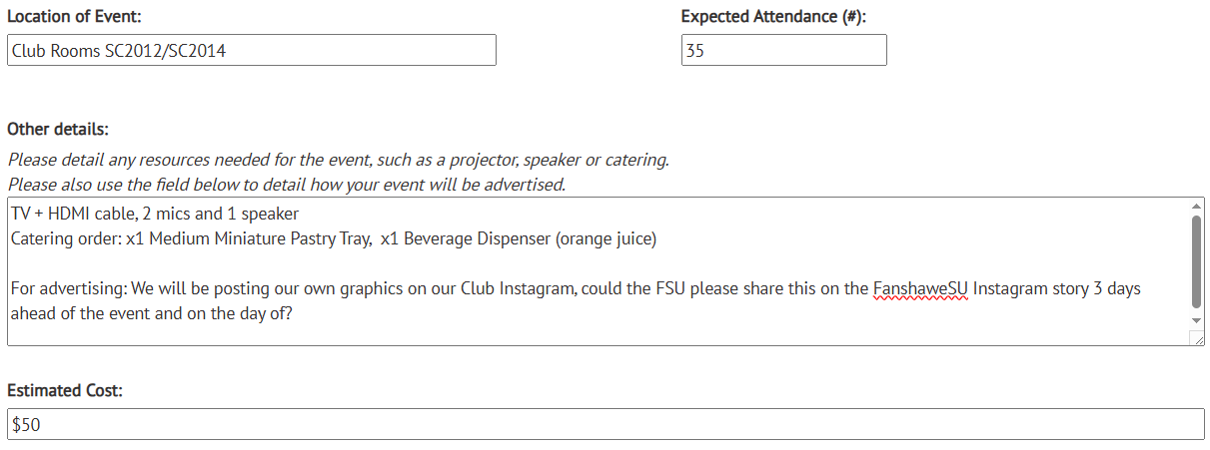
Event & Activity Application Form
Other Details
List any resources needed for the event (e.g. speakers, projectors or monitors, catering, etc.) as well as how the event will be advertised. You can follow the template below:

Slide 12
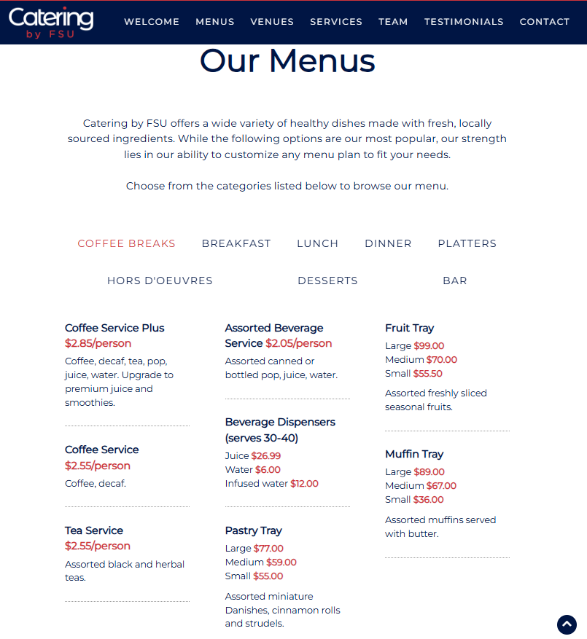
Catering with the FSU
Clubs can book catering for approved events through the FSU at a 50% discount within FSU Spaces, subject to availability. This is directly charged back to a Club Account if the club is eligible for funding.
Check https://www.fsu.ca/catering for the menu and list each item and amount you would like to order in your Event Application Form. Instructions on how to confirm catering orders will be sent after an event is approved, along with the invoice after final confirmation.
Specific catering requests must be submitted one (1) month in advance and there are no guarantees that the items can be provided. Note that no outside food is permitted in FSU or Fanshawe College spaces.

Slide 13
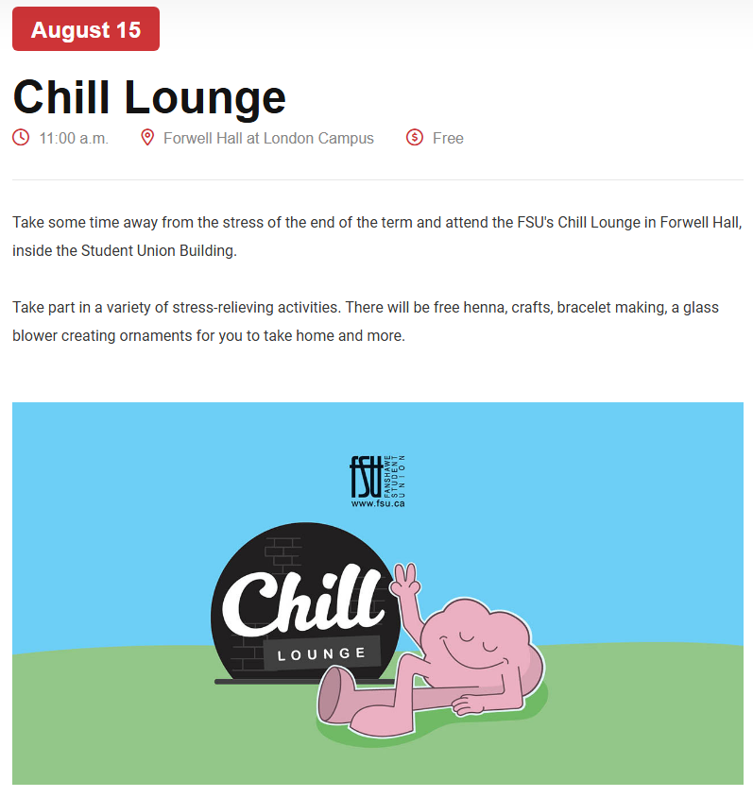
Advertising with the FSU
Club events, along with the club itself, can be advertised in different ways! These can be listed on www.fsu.ca/events, posted on FSU Social Media, and posters can be put up around campus. Clubs are mostly responsible for creating the publication materials for their advertising; however, they can request for help from a FSU Graphic Designer.
Events Site Listing
To add your club event to the FSU Event listings, include a brief description of the event and a 1280 x 670 banner.
FSU Social Media
To have your event or club promoted on FSU social media, write up a caption and include a 1080 x 1350 graphic. Optionally, clubs can post this on their own social media pages and request that the FSU shares it on social media stories/reels.

Slide 14

Advertising with the FSU
Bulletin Board Posters
There are over 50 FSU Bulletin Boards all over campus. Included in the Event Application Form, as well as on the FSU Clubs website, is a link to the downloadable template for posters. You can attach your graphic to the template and upload it to your application form.
After the event and the poster are approved, clubs have the option to print the posters themselves and submit the receipt for reimbursement from their club funds. Alternatively, the FSU can print the posters, and printing costs would be deducted from the club funds. The FSU Poster Team is responsible for posting these on the bulletin boards every week.

Slide 15
Event & Activity Application Form
Once your Event Application Form has been submitted, the FSU Executive Committee will review the submission and inform the club of whether the event is approved or not.
Only after approval can the club proceed with subsequent planning and preparation:
Securing the event location: Confirm with the FSU Clubs team or Conference Centre whether the selected location is available during the time and date of your event.
Confirm catering order: After an Event Application is approved, the FSU Hospitality team will send an invoice to confirm your catering order and the amount that would be deducted from the club funds.
Purchasing items/materials: Prizes, decoration, etc. can only be bought after approval. Remember to keep the receipts for reimbursement!

Slide 16

Events Guide – Movie Nights
Movie Nights
Everyone loves a classic movie night, and these events typically do well with Fanshawe students. However, a license is needed to show a movie publicly, so films only available on Criterion Pictures or Audio Cine Film list(s) can be shown at Club events.
When filling in your Event Application Form, make sure to add the movie title and the link to the Criterion or Audio Cine Film listing. Note that if the event is approved, promotion is limited to on-campus promotion only (printed posters).
TIP: Want to serve popcorn at your movie night?
You can request popcorn from FSU Hospitality! 🍿
Include this under “Other Details” along with the number of
servings you’d like to initially have. More popcorn bags
can be requested at the day of your event, and it will
be included in your invoice.

Slide 17

Events Guide – Off-Campus Events
London has a lot of fun sites for clubs to hold events at! A few famous spots for Club get-togethers are Tilt Arcade and the Rec Room.
Note that the approval for off-campus events may vary depending on the activities
involved. Also note that the FSU is not responsible for any travel arrangements and
will not be held liable for any injuries or accidents that may occur. Plan accordingly
and responsibly and talk your event plans over with the FSU Clubs team first!
If the club leaders overlook travel arrangements, some other requirements
will be requested by the FSU like waiver forms or insurance certificates.
Remember: To avoid risks of injuries, the FSU will not recognize or approve
high-risk events or activities.

Slide 18
Forms and Reports
Club Locker Application
The FSU may provide a club locker, free of charge, for leaders to store things such as prizes, materials, etc. Note that this on a first come, first served basis as spots are limited. These lockers are located in the Student Centre building, next to the SC2012/SC2014 Club Rooms.
After submitting an application, club leaders will be contacted to set an appointment for locker assignments and guidelines.
End of Term/Year Reports
Leaders will have to submit a report of activities performed by the club at the end of each term and academic year. These forms are all available online at www.fsu.ca/clubs under the “FSU Club Forms” sidebar, along with other forms that you might need throughout your club’s operations.

Slide 19

Have more questions?
Contact the VP, Student Engagement
fsustudentengagement@fanshawec.ca
Or the FSU Clubs Team
fsuclubs@fanshawec.ca

